Slide 1
Modernising Paediatric antimicrobial medicines surveillance: A data science approach
Dr S Channon-Wells
Clinical PhD fellow in Paediatric Infectious Disease
Imperial College London

Slide 2


The problem
Antimicrobial consumption levels are a key metric for effective stewardship
Children are particularly at risk from antimicrobial resistance (Lancet: GRAM report 2022)
The methods used to assess antimicrobial use in children are very limited
Minimal systematic data available for paediatric prescribing, especially in hospital patients (highest risk)
Notes:
We need to be able to effectively monitor antimicrobial use (antibiotics, antivirals, etc) to be able to understand what are the issues, and how to best spend resources improving prescribing practices. How do we improve if we don’t know the baseline? How do we share best practices if we don’t know who is doing best? How do we research strategies to improve prescribing and to reduce AMR if we don’t know what prescribing patterns are?
AMR is a particularly big issue in children, with young children highlighted as a key
Methods used to assess antimicrobial use in children are very biased towards adult populations, and so they heavily limit the use of this data.
As a result, very few systematic data are available

Slide 3


Issues with paediatric data
Few reports separate paediatric and adult data
Primary care ahead of secondary care in UK (ePact2)
Inappropriate metrics for children
Secondary care data taken mostly from dispensary records or point-prevalence surveys
Understanding trends in paediatric consumption is particularly challenging – high variability (inter- and intra-trust)

Slide 4
Our work in Oxford
Electronic prescribing records contain rich data – not being used!
Allows refined analysis:
Use of paediatric-appropriate metric
More granularity
More statistically robust techniques
Comparison of different metrics
Aims:
Make best use of available data to help the antimicrobial stewardship team
Present data in flexible and interpretable format
Notes:
Realisation that electronic prescribing records all the data we need – not being used!
Previous work at GOSH demonstrated the additional insights we get from using electronic prescribing data:
Direct comparison of metrics
Evaluation of initiatives to improve prescribing
Can account for additional factors explaining variability in the data – eg. The day of the week, periodic effect, etc. (more statistically robust)
Wanted to make best possible use of this data – allow clinicians/pharmacists to access the data easily in a format that is useful for them

Slide 5
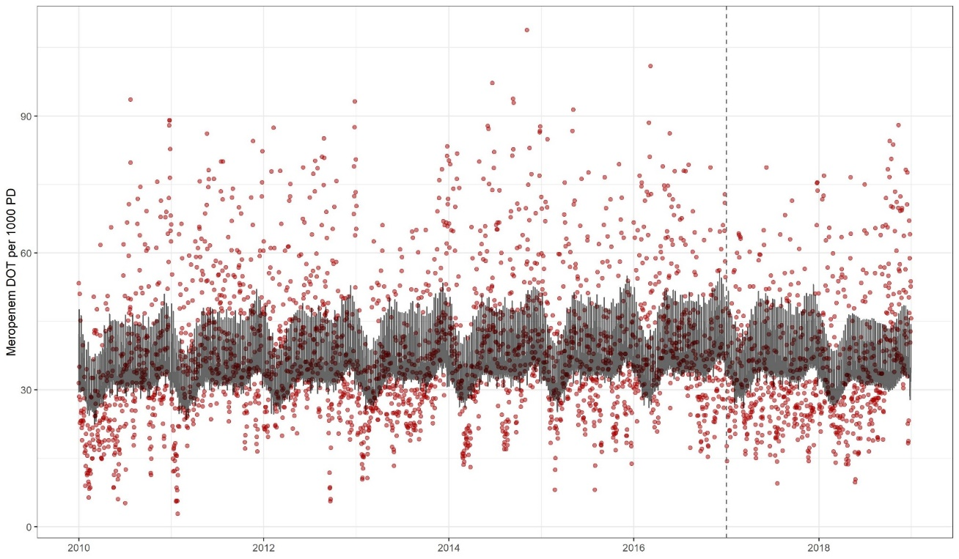
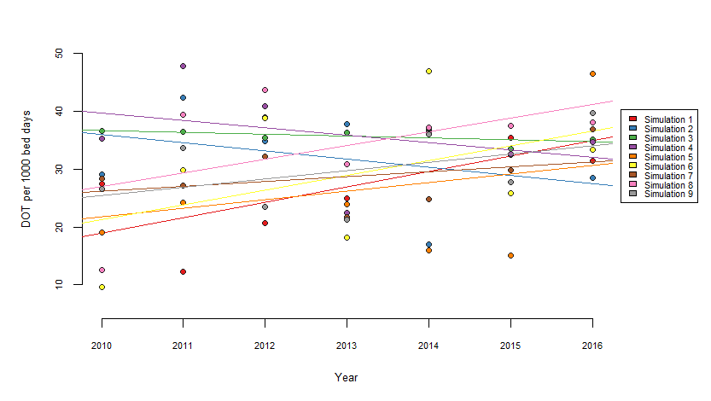
Continuous data
Simulated point-prevalence surveys
1.3% Annual Increase
6.6% Annual Decrease
High variability in estimates
Start of stewardship program
Notes:
Comparison of continuous data and simulated point-prevalence data to estimate trends (for Meropenem)
Granularity of the data immediately apparent – but not being used by most centres!

Slide 6


Slide 7
Informatics team
Information governance team
Clinicians
Pharmacists
Previous experience
Identify existing packages

Slide 8
Informatics team
Information governance team
Clinicians
Pharmacists
Previous experience
Identify existing packages
Static data export
Establish data cleaning pipeline
Built prototype dashboard
R and R-shiny

Slide 9
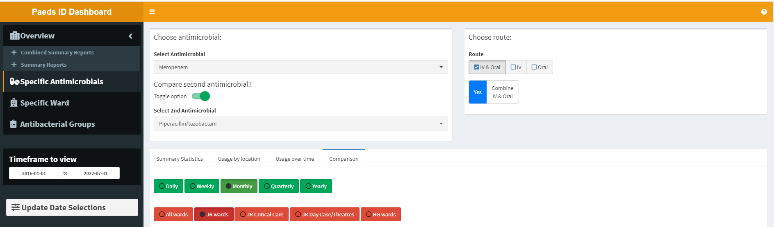
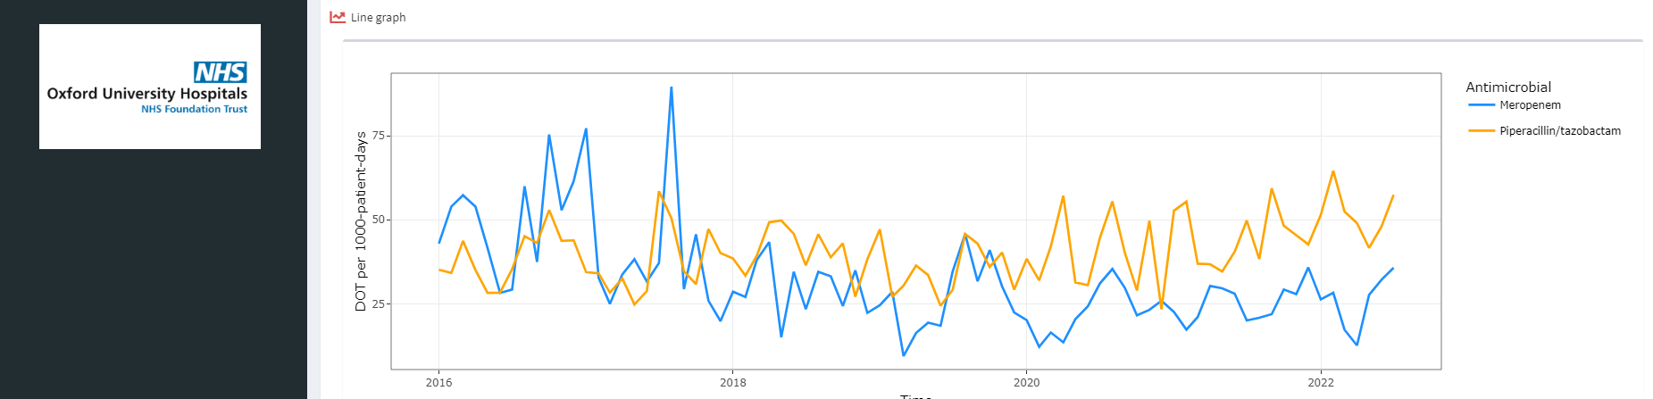
Reactive inputs
Multiple functionalities
Downloadable interactive graphics

Slide 10
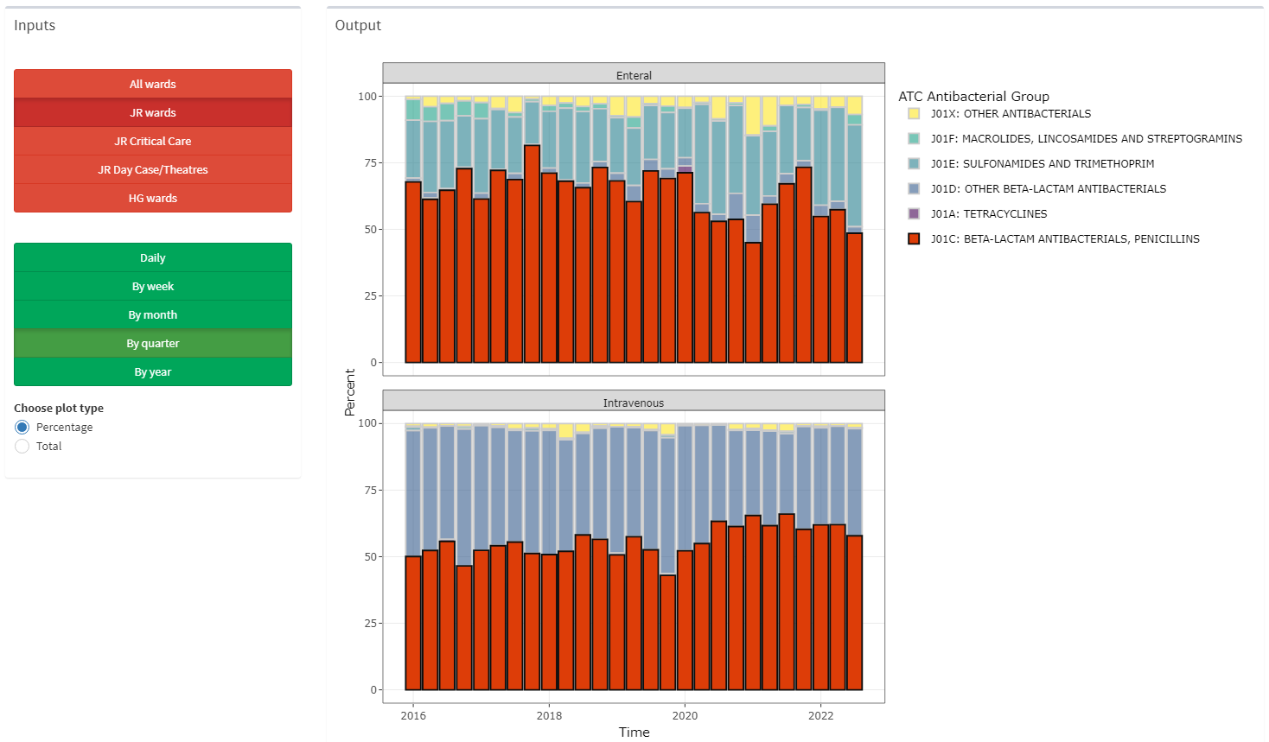
Choice of plot type

Slide 11
Informatics team
Information governance team
Clinicians
Pharmacists
Previous experience
Identify existing packages
Static data export
Establish data cleaning pipeline
Built prototype dashboard
R and R-shiny
Review data against expectations
Review by end-users
Identified additional functionalities required

Slide 12
Adjust/enhance functionality
First implementation
Allow monthly data updates
Regular performance review
Informatics team
Information governance team
Clinicians
Pharmacists
Previous experience
Identify existing packages
Static data export
Establish data cleaning pipeline
Built prototype dashboard
R and R-shiny
Review data against expectations
Review by end-users
Identified additional functionalities required

Slide 13
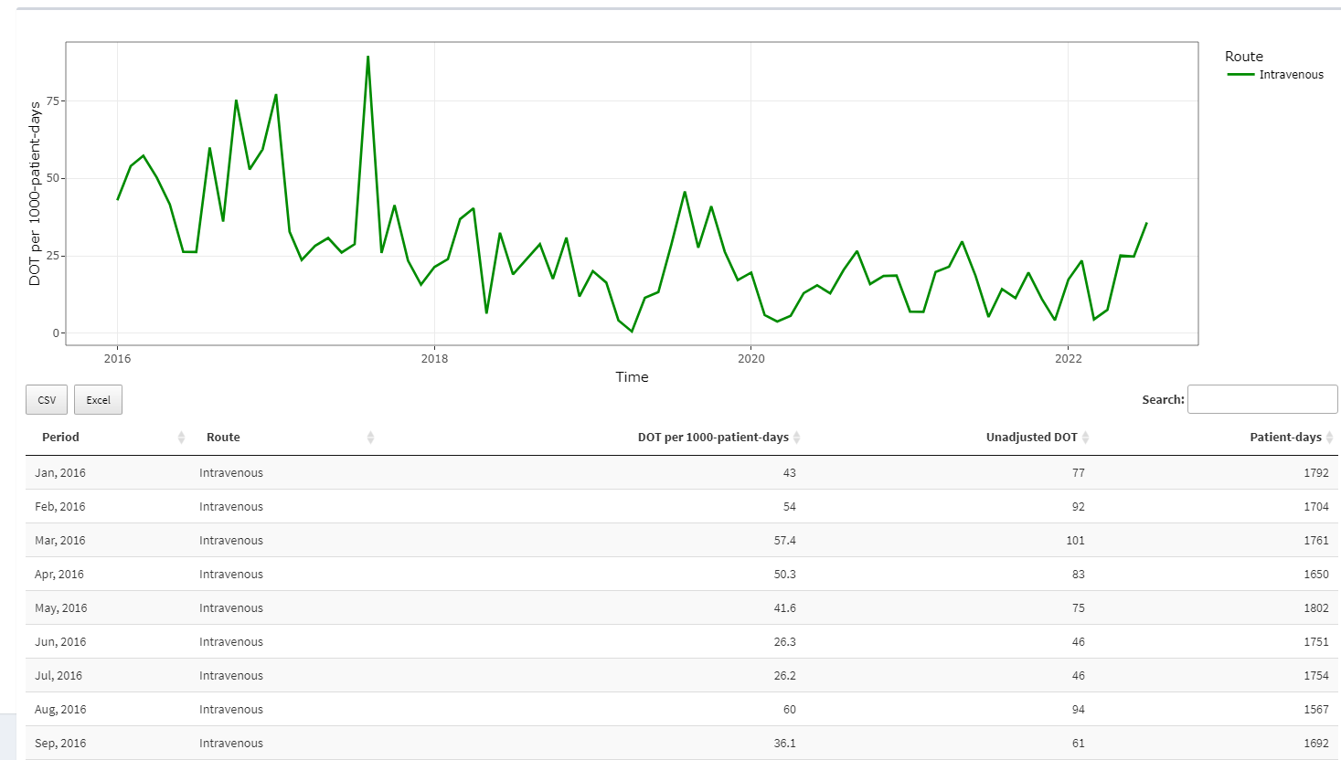
Exportable tables for further analysis

Slide 14
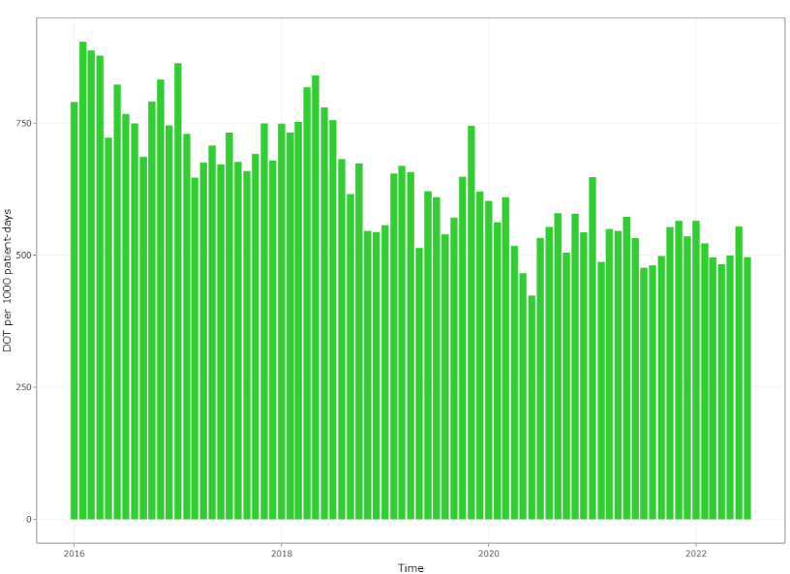
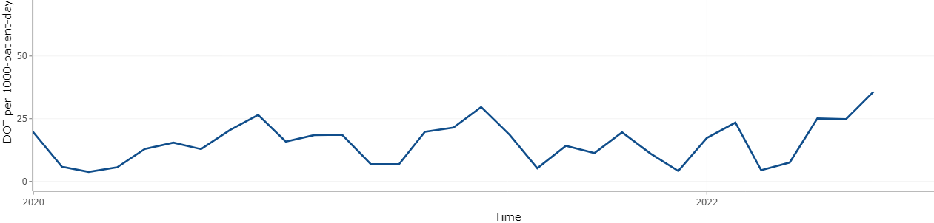
Impact so far
Demonstrated reduction in overall antibiotic use after stewardship intervention
Facilitates prompt detection of abnormal trends needing further investigation
Abnormally high meropenem use

Slide 15
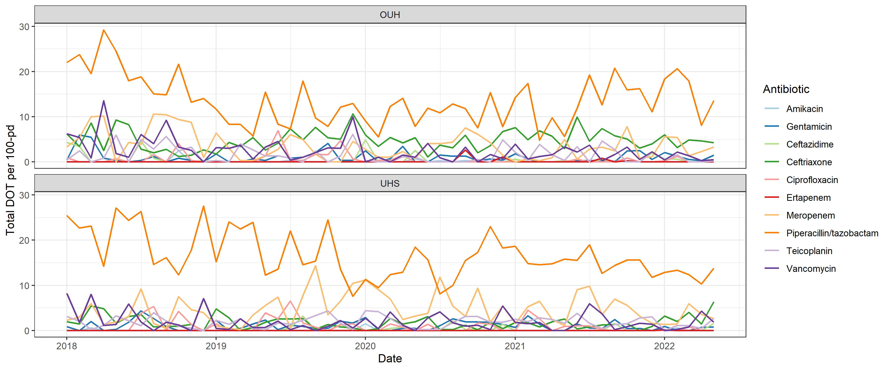
Impact so far
Enabled pilot project in collaboration with another children's hospital

Slide 16
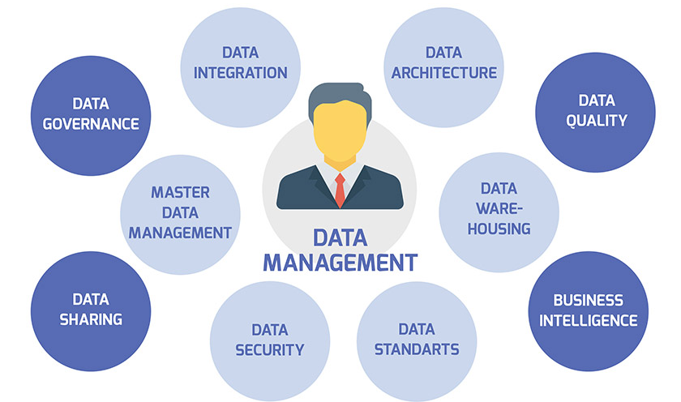

Challenges
Information governance
Internal IT infrastructure
Lack of familiarity with R
Difficult to assimilate with existing infrastructure
Maintenance
Data downloads and quality checks
Platform maintenance – debugging/updating
Not funded – goodwill project

Slide 17
Future aims
Enhance functionality of dashboard
Use dashboard results to evaluate and enhance existing AMS projects at the trust
Expand to additional centres – benchmarking between sites/sharing best practice
Incorporate antimicrobial resistance data – would allow us to explore relationship between prescribing and resistance
Request funding to ensure durability
Develop into R-package?
Antimicrobial usage
AMS policy/
interventions
AMR surveillance

Slide 18
Take home messages
Vast amounts of data not currently being used
Increasing visibility and interpretability of the data is powerful
Don’t need complex methods/statistics to be impactful
Hardest parts
Data management/information governance
Implementation/integration of R-shiny in trust IT infrastructure
Maintenance

Slide 19
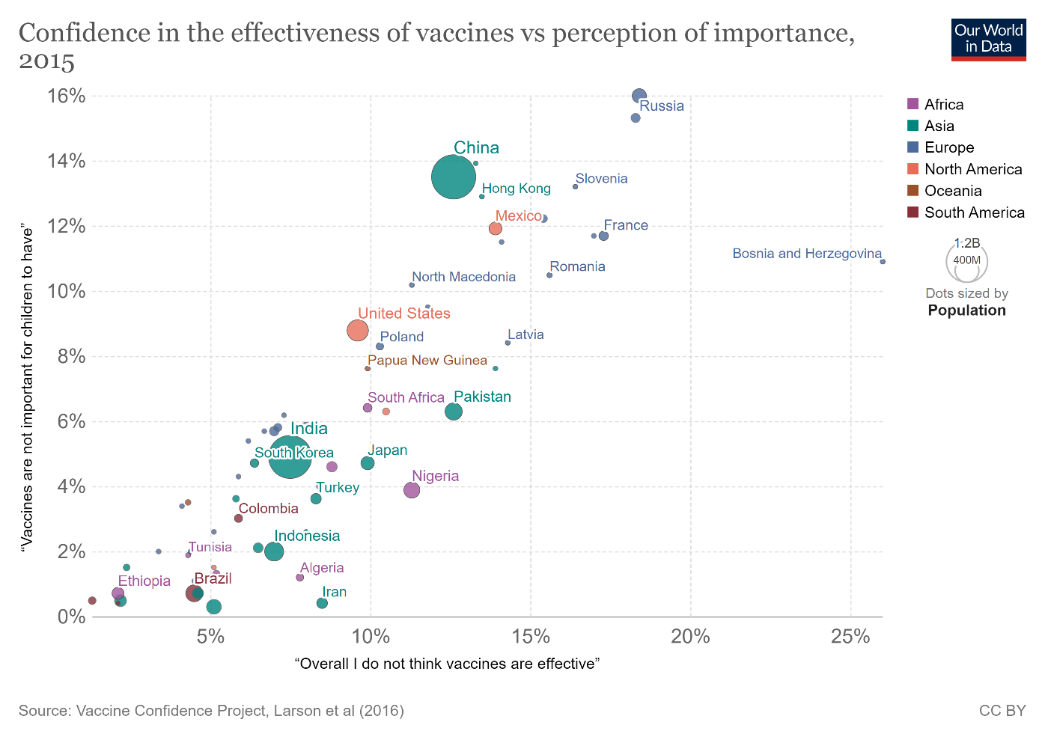
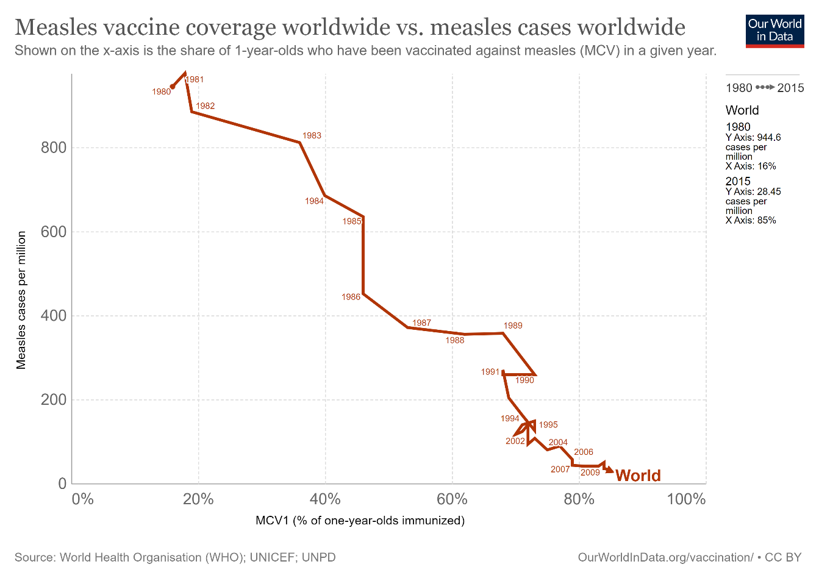

Slide 20





Acknowledgements
Oxford:
Stéphane Paulus
Caroline Herin
Informatics teams at
Southampton:
Sanjay Patel
Others:
Adam Irwin
Peter Diggle
Joe Standing
Jonah Kwok
John Booth
Garth Dixon
Alasdair Bamford

